Slide 1
Carlos Vega

Slide 2
About me
I was born and raised here in Lindsay CA.
I live with one older sibling his name is Jorge Vega.
I also live with both of my parents.
I currently own a 5-month-old German shepherd.

Slide 3
High School Experience
My high school experience has been like a roller coaster.
It has been easy being on pace recently.
I learned to stop procrastinating.
I learned to be more focused on my work.
And I learned to be more self-sufficient.
I've been a part of Red Zone and FFA.

Slide 4
Job Shadow
The person I job shadowed was Camilo, a farm consultant.
He makes sure that the workers who pick oranges and the supervisor who marks that amount of boxes they make stays organized.
We traveled to Orosi.
I liked how he was checking in with the supervisor to make sure everyone gets paid of the amount they made.

Slide 5
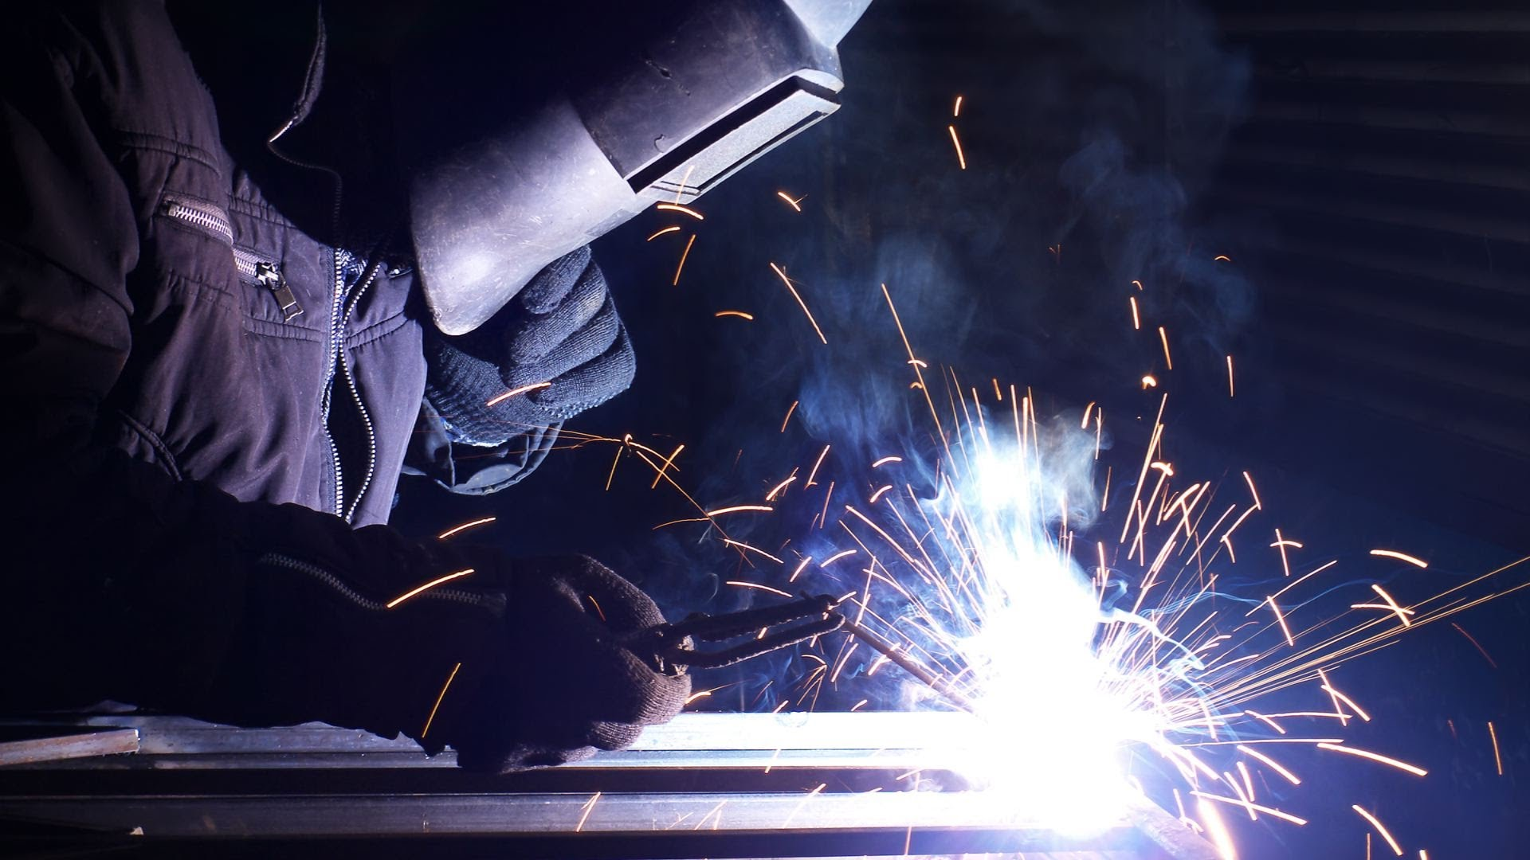
Pathway
My pathway was Industrial Arts but they replaced it and turned it into Ag Mechanics.
My old pathway was about Wood, Auto, and Engineering for the first year.
For my second and third year I was working on projects that were wood based like a bird house, planter box, and a little wooden bench.
My last year Wood was removed and replaced with Ag Mechanics that involved welding and learning how to drive a tractor as well as a forklift.

Slide 6
Post High School Plans
My post high school plans are to go to COS and study Criminal Justice for 2 years then transfer to a 4 year university. But if I lose interest in this subject I have Ag Mechanics or Ag Business to fall back on.

Slide 7
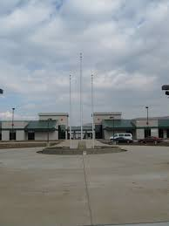
Leaving LHS
I will miss some of the teachers.
I made some really great friends.
I can't wait for graduation/college.

Slide 8
Thank You
Any Questions?

